Slide 1
Burger backend

Slide 2

Disclaimer

Slide 3
Agenda
Domain model
API Design
Monolithic approach
System architecture (security, scaling)
Database design (user privacy)
Microservices
System architecture
Data structures
Monolith implementation (principles)

Slide 4
Requirement 1
Users can review local burger places, scoring them based on taste, texture and visual presentation. The users are also able to upload a picture of their burgers, in order to entice fellow burger fanatics.

Slide 5
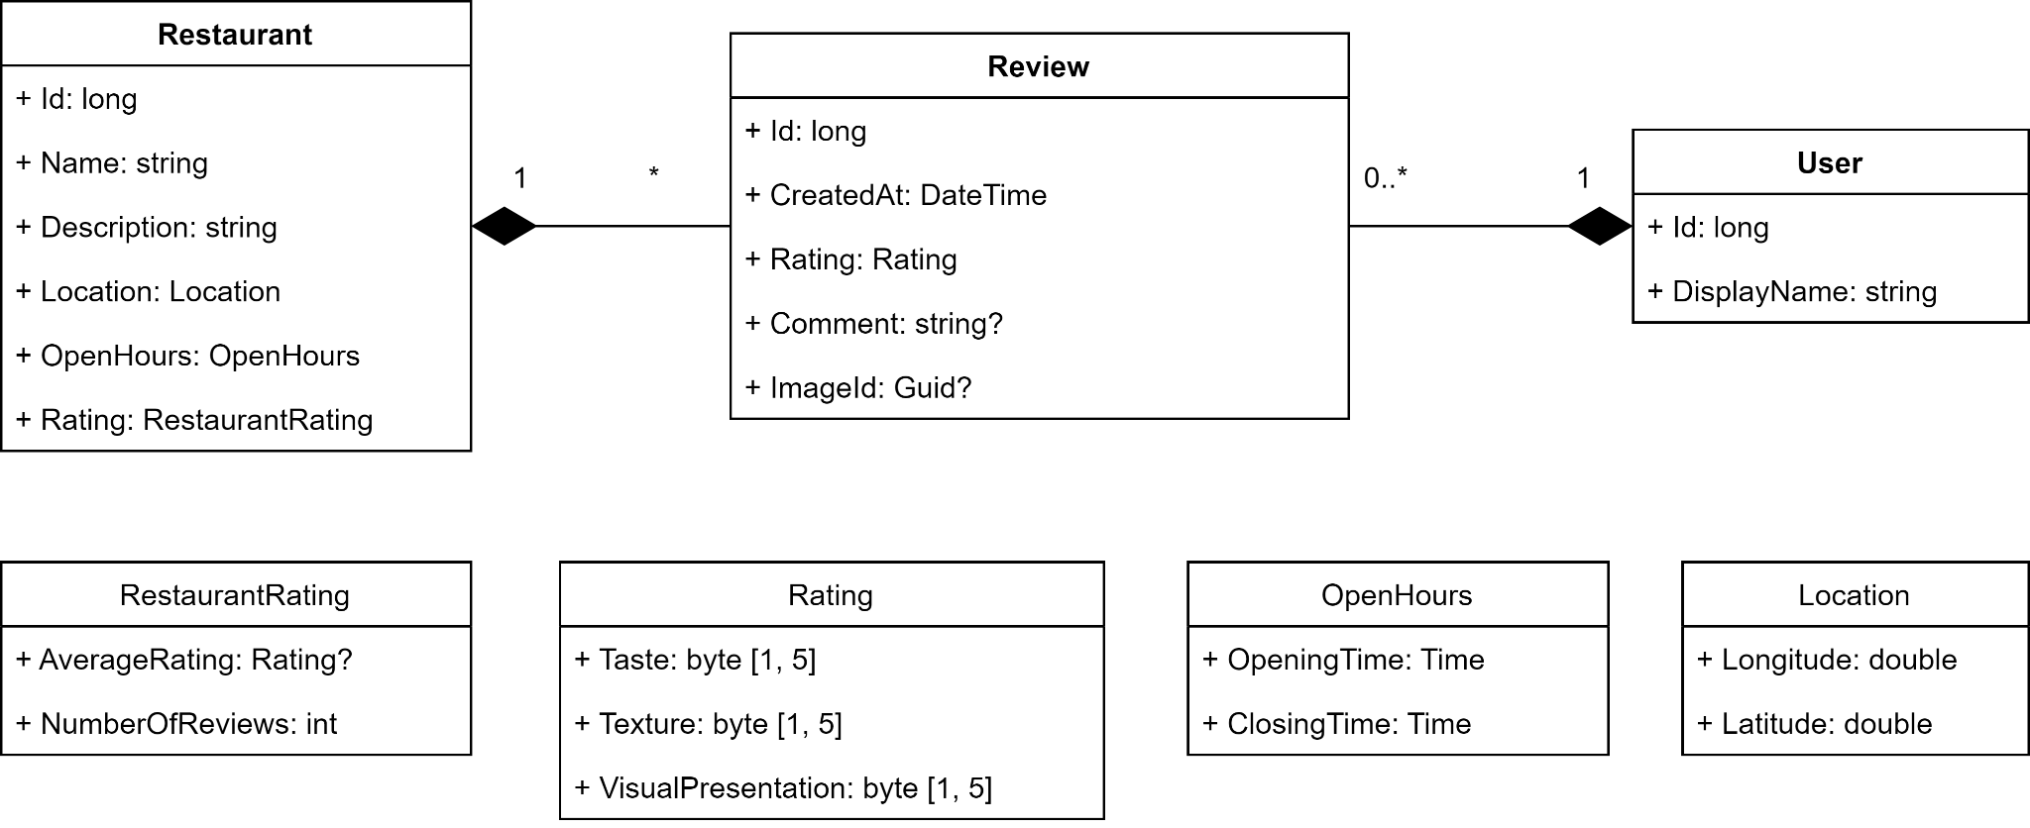
Domain model

Slide 6
Requirement 2
The user is also able to find nearby restaurants with burgers on the menu, read information about location and opening times.

Slide 7
Domain model

Slide 8
API Design
Add a review (only logged in users).
Finding basic information (location, open hours, average rating) about nearby restaurants.
Fetching reviews for a specific restaurant (pagination).
Mobile vs Web.

Slide 9
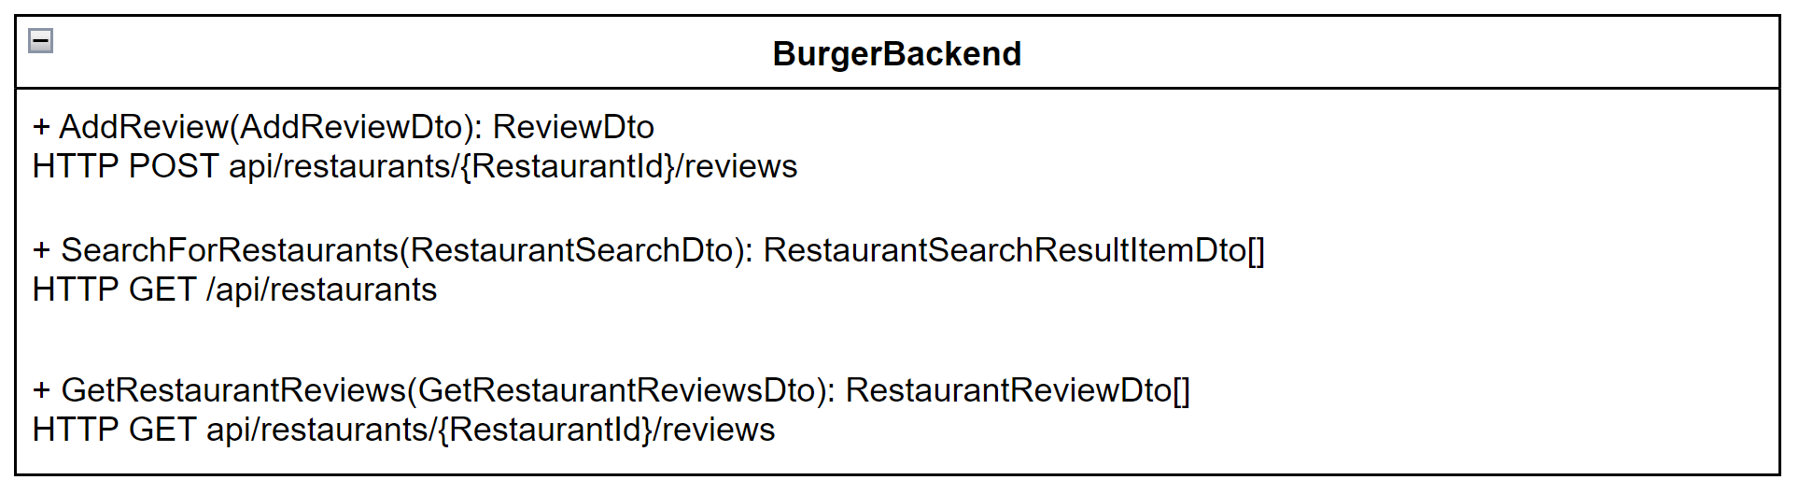
API Design

Slide 10
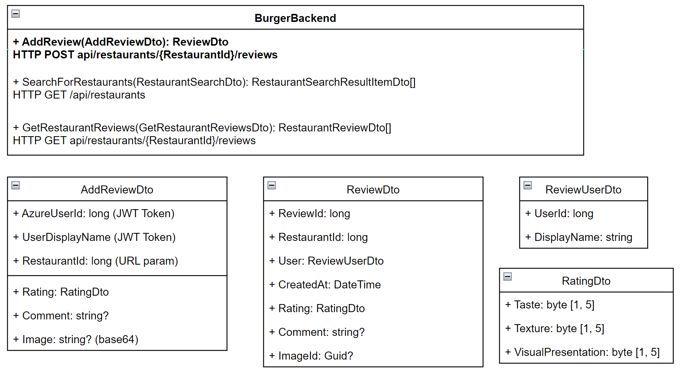
Add a review

Slide 11
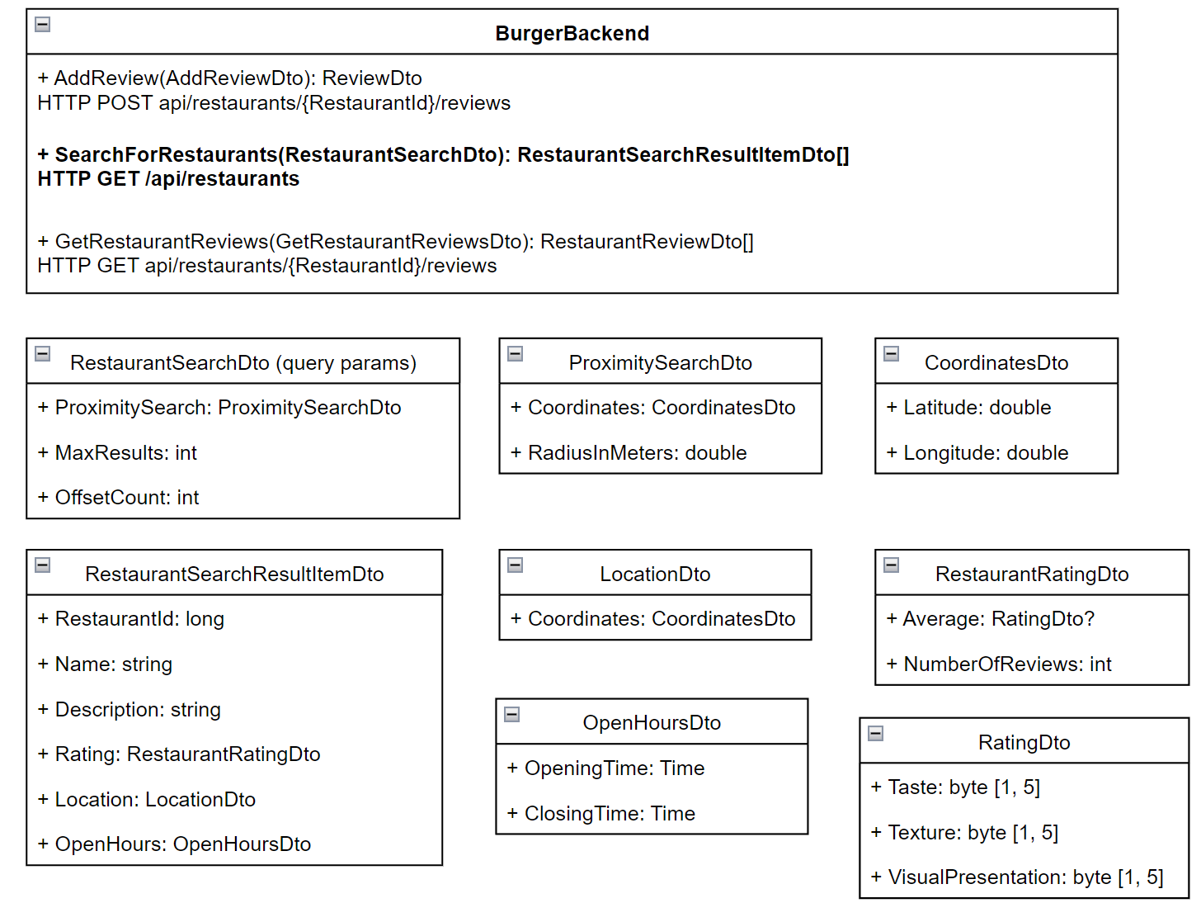
Find nearby restaurants

Slide 12
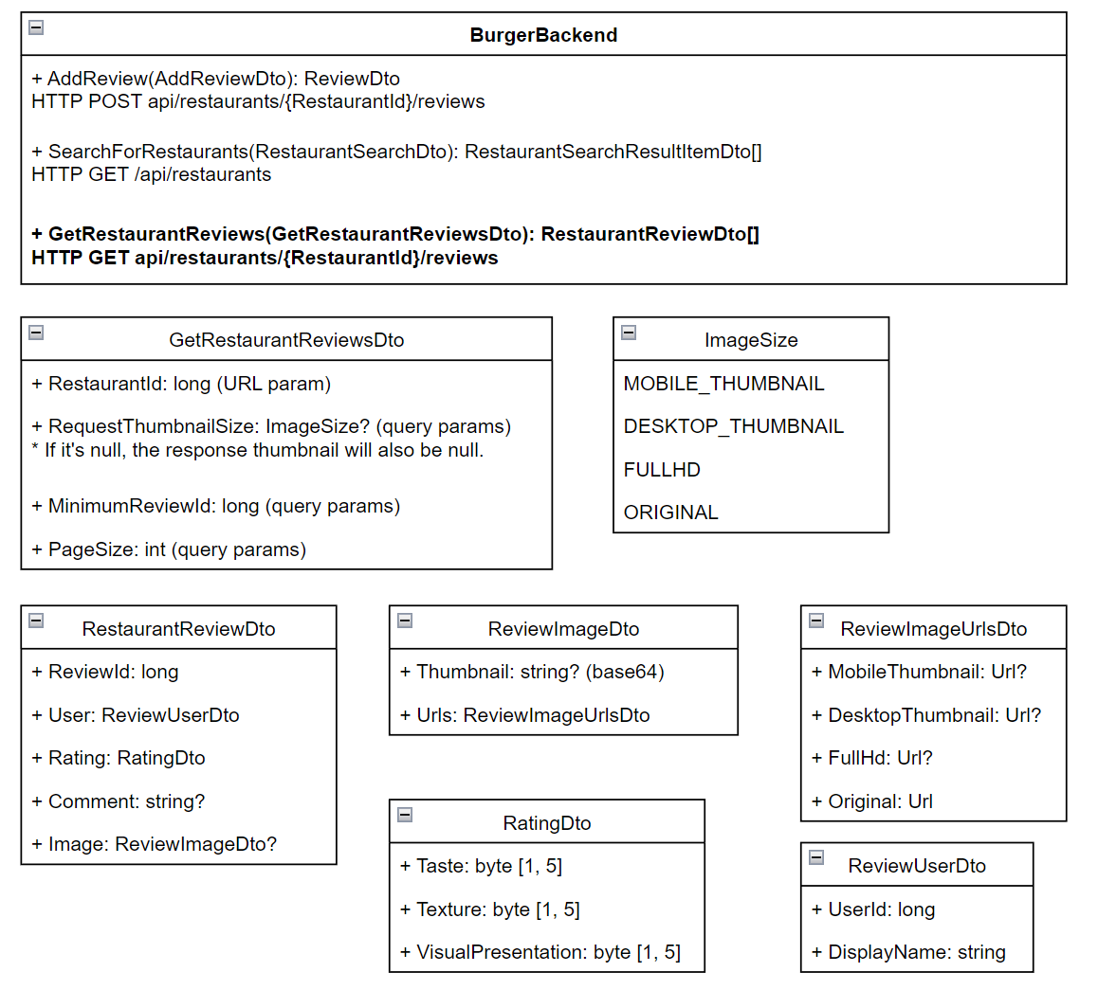
Get Restaurant Reviews

Slide 13
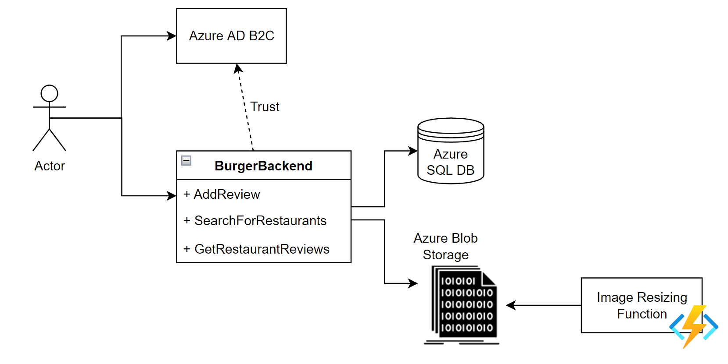
System architecture

Slide 14
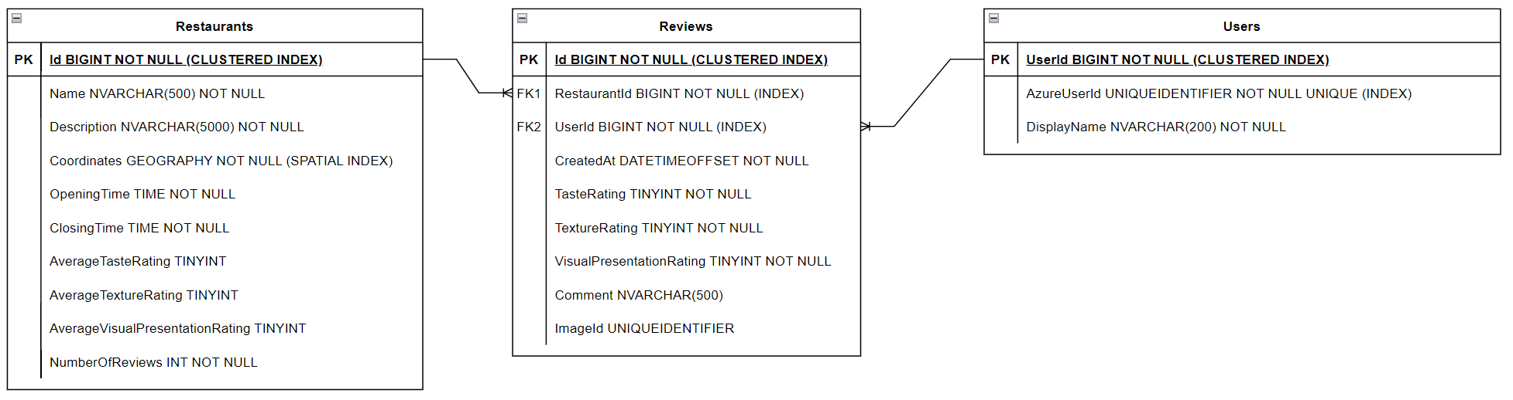
Database
Notes:
Indexes.
Restaurant Average rating - triggers.
User’s DisplayName.

Slide 15
Questions

Slide 16
Microservices

Slide 17
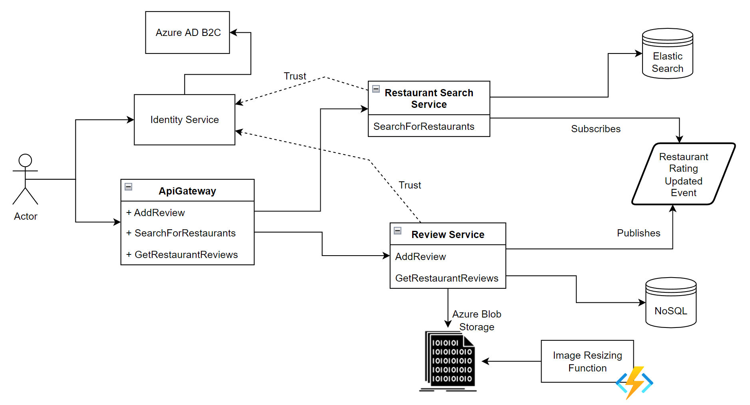

Slide 18
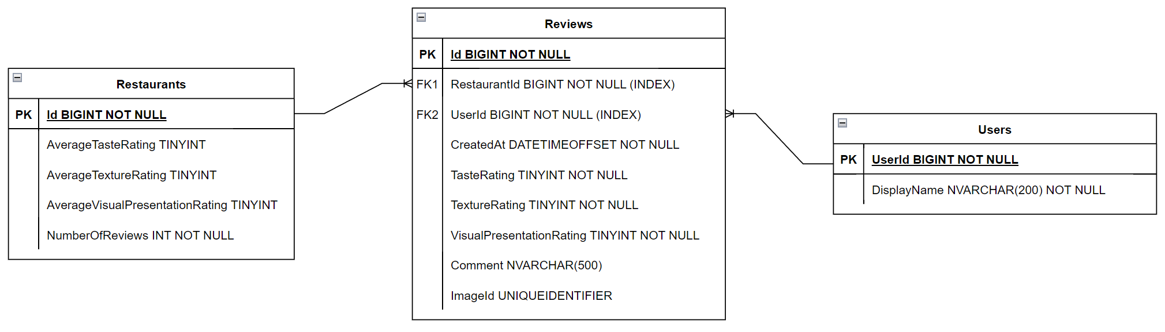
Review service data structure

Slide 19
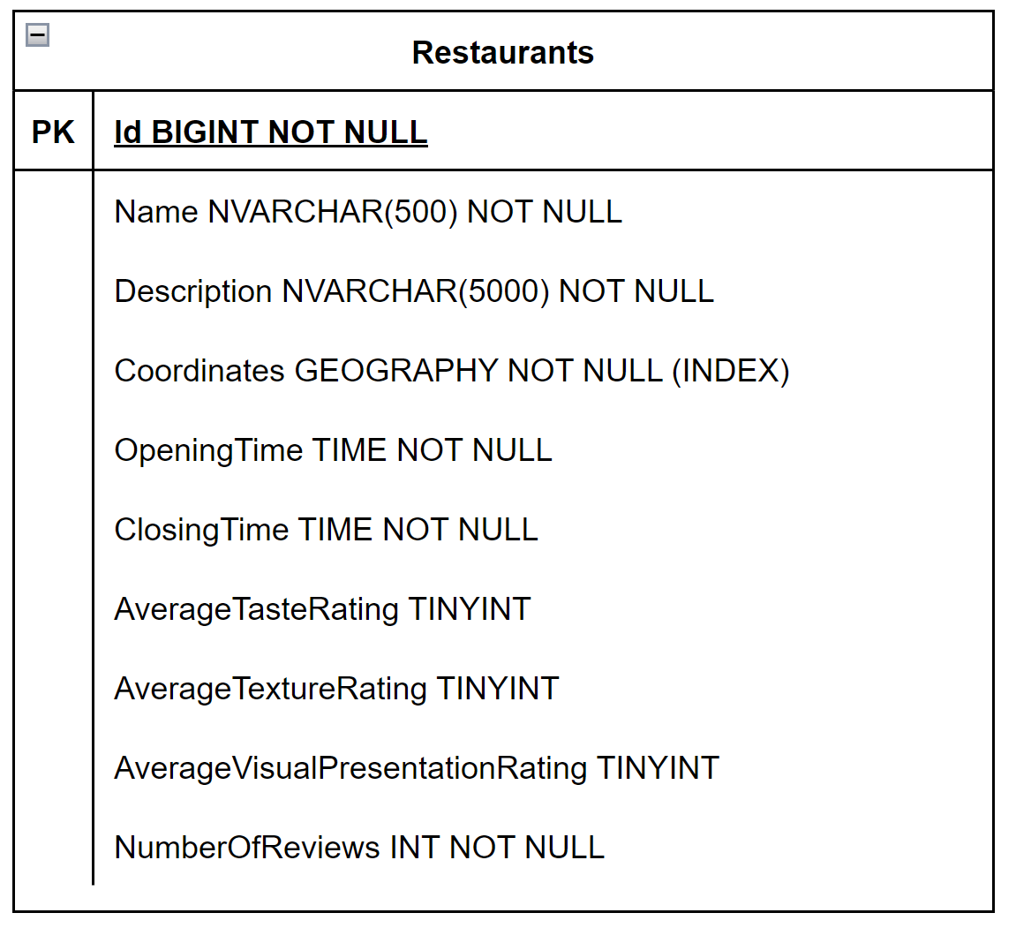
Search service data structure

Slide 20
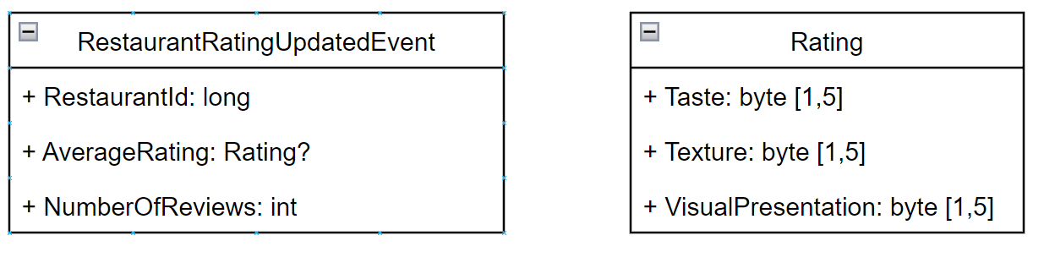
Restaurant rating updated event

Slide 21
Questions

Slide 22
Implementation

Slide 23
Questions

